Slide 1
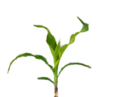
Soil test P with history of broadcast P fertilizer in no-till

Slide 2
Soil test P with history of band-applied P fertilizer in strip-till

Slide 3
Stratification/changes in soil pH with N application methods/source
UAN w/ strip-till
Anhydrous-Ammonia

